Slide 1

DEPARTMENT OF COMPUTER SCIENCE AND ENGINEERING
ACS COLLEGE OF ENGINEERING
KAMBIPURA, MYSORE ROAD, BANGLORE-74
8th Sem Project Review on:
CERTIFICATE VALIDATION USING BLOCKCHAIN
Presented By: Vishal Prasad Sharma(1AH21CS3) Anayat Altaf Shah(1AH21CS127) Raj Kumar(1AH21CS081)
Vandan Kumar M(1AH21CS117)

Slide 2
OBJECTIVE
Blockchain technology has recently emerged as a potential mean for authenticating the document verification process and a significant tool to combat document fraud and misuse.
This project aimed to enhance the document verification process using blockchain technology.
This Project also identifies the gaps and loopholes in the current blockchain based educational certificate verification solutions.

Slide 3
ABSTRACT
In the digital world, each and every thing are digitized in which the academic certificate are digitized in the educational institution and provided to the students.
The increase in security breaches compromise user’s privacy of academic digital certificate.
The institution and organization find it very difficult to validate and verify the digital certificates
By using blockchain technology we can provide a more secure and efficient digital certificate validation.

Slide 4
PROBLEM DEFINITION
A skillfully generated fake certificate is always hard to detect and can be treated as the original.
With the increase of forged documents, credibility of both the document holder and the issuing authority is jeopardized.

Slide 5
OVERVIEW
A blockchain is a growing list of records called blocks, that are linked using cryptography.
Each block contains a cryptographic hash of the previous block and a timestamp.
It is resistant to modification of the data

Slide 6
LITERATURE SURVEY
SURVEY | AUTHOR | YEAR | EXPLANATION
SURVEY 1: Blockchain and smart contract for digital certificate | Jiin-chiou etal.,, | 2024 | generate the electronic file and calculate hash value for it. system creates a QR-code Pros : certificate granting are open and transparent in the system. Cons : QR-code must be scanned with smartphone and internet connection is required.
SURVEY 2: Blockchain based certificate transparency and revocation | Zewang Jingqiang Lin etal.,, | 2023 | CAs signed certificates and their revocation status information of an SSL/TLS web server are published by the subject and append it to the global certificate blockchain . Blockchain act as public logs to monitor CAs certificate signing and revocation operations Pros: Avoids the certificate fraudulent Cons: : Certificate validation delay and false sense of security
Survey 3: Certificate transparency using blockchain | Dsv madala etal.,,, | 2022 | Hyperledger fabric is used. CTB smart contract. Pros : logs-consistency Cons: low scalability and less transaction

Slide 7
Existing System
Generate the electronic file of a paper certificate
Used to verify the authenticity of the paper certificate through Hyper ledger Platform.
Disadvantages of existing system:
Verification has to be done manually by sending certificate to Academic centre. Which is time consuming.
Hyperledger cannot use public block chain because of privacy and low scalability .
Hyper ledger preferred platform only for B2B business.

Slide 8
PROPOSED SYTEM
Using blockchain and QR code technology for certificate verification is a secure and efficient way to authenticate documents.
Here's a high-level overview of how you might implement a blockchain QR code-based certificate verification system:
Create a digital certificate for the recipient, containing relevant information such as the recipient's name, the issuing authority, the date of issuance, and details about the achievement or qualification.
Generate a unique identifier (hash) for the certificate, preferably using cryptographic hashing algorithms such as SHA-512.

Slide 9
PROPOSED SYTEM
Choose a blockchain platform (e.g., Ethereum, Hyperledger, or a custom solution) for storing certificate data. Ensure that the chosen blockchain supports smart contracts.
Create a smart contract that stores the certificate details along with its unique identifier on the blockchain. The smart contract should include functions for certificate verification.
Linking Certificate to QR Code:
Generate a QR code containing the unique identifier or a link to the smart contract on the blockchain.
Embed the QR code on the digital or physical certificate.

Slide 10
PROPOSED SYTEM
Recipients or third parties can use a QR code scanner on a mobile device to scan the QR code on the certificate.
The scanner retrieves the unique identifier or smart contract link from the QR code.
Use the unique identifier to query the blockchain smart contract for the corresponding certificate information.
The blockchain verifies the authenticity of the certificate by matching the unique identifier with the stored data.

Slide 11
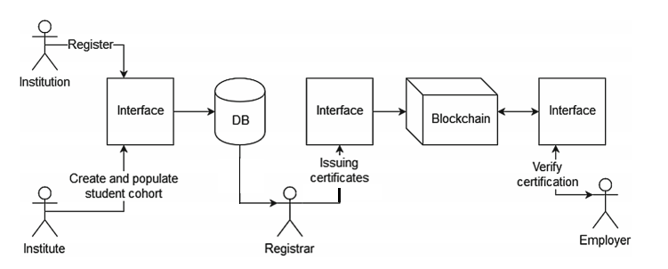
PROPOSED SYSTEM ARCHITECTURE

Slide 12
ADVANTAGES OF PROPOSED SYSTEM
By using the unmodifiable property of blockchain provide more security.
Confidentiality is transparent with each transaction visible to all the peers.
Run an application in offline mode.
Certificate is validated rapidly.
Provide accurate and reliable information

Slide 13
FUTURE OF THIS PROJECT
Web and Mobile Integration: Extend the desktop application to web and mobile platforms for greater accessibility and convenience.
Advanced Security Features: Implement encryption and multi-factor authentication for enhanced data protection.
Decentralized Identity Management: Allow users to manage their digital identities on the blockchain alongside certificates.
Scalability Enhancements: Optimize performance for handling larger datasets and multiple institutions.
Real-Time Notifications: Notify users instantly about certificate updates, revocations, or verifications.

Slide 14
Thank You

